Slide 1

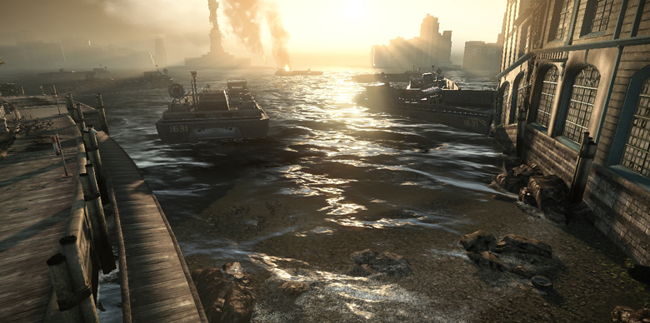
Graphics for Games CPI 411

Slide 2
Today's Contents
Programmable Shader (Look at the posted another slide)
C# and MonoGame Basics
Simplest HLSL

Slide 3
Review C#
Syntax: C# is similar to Java, C/C++
Object Oriented Programming (OOP)
Class Definition and Inheritance

Slide 4
Review: MonoGame in VS
Solution with multiple projects
Game Program
Properties
Initialize()
ContentLoad()
Update()
Draw()

Slide 5
Review: 3D Game Dev
Prepare 3d data as FBX files and texture images
Add them to the content through MonoGame's Pipeline
In main program (usually named as Game1.cs),
Load the resource files using
data = Content.Load<type of data> ("name of data");
Add the key controls in the Update() method
if(keyboardState.IsKeyDown(Keys.Left)) {...}
Draw the data using one of the built-in methods
graphcs.DrawIndexedPrimitives(...);
graphcs.DrawPrimitives(...)
graphcs.DrawUserPrimities(...)
graphcs.DrawUserIndexedPrimitives(...)

Slide 6
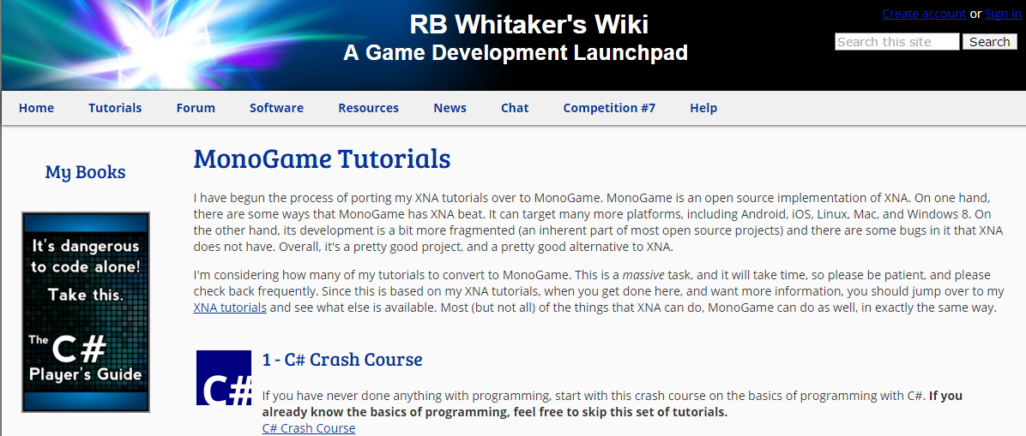
References
http://rbwhitaker.wikidot.com/monogame-tutorials
This site has good C#, XNA, and MonoGame Tutorials.

Slide 7
First HLSL
Vertex Shader
Pixel Shader
Syntax of HLSL
http://msdn.microsoft.com/en-us/library/bb509638(VS.85).aspx

Slide 8
Simplest Shader
float4 MyVertexShader(float4 position: POSITION) : POSITION
{
return position;
}
float4 MyPixelShader(): COLOR
{
return float4(1, 1, 1, 1);
}
technique MyTechnique
{
pass Pass1
{
VertexShader = compile vs_4_0 MyVertexShader();
PixelShader = compile ps_4_0 MyPixelShader();
}
}

Slide 9
Test Program (Game1.cs)
Effect effect;
VertexPositionColor[] vertices =
{
new VertexPositionColor(new Vector3(0, 1, 0), Color.White),
new VertexPositionColor(new Vector3(1, 0, 0), Color.Blue),
new VertexPositionColor(new Vector3(-1, 0, 0), Color.Red)
};
...
protected override void LoadContent(){
...
effect = Content.Load<Effect>("SimplestShader");
}
protected override void Draw(GameTime gameTime){
foreach (var pass in effect.CurrentTechnique.Passes)
{
pass.Apply();
GraphicsDevice.DrawUserPrimitives<VertexPositionColor> (
PrimitiveType.TriangleList, vertices, 0, vertices.Length/3);
}
}

Slide 10
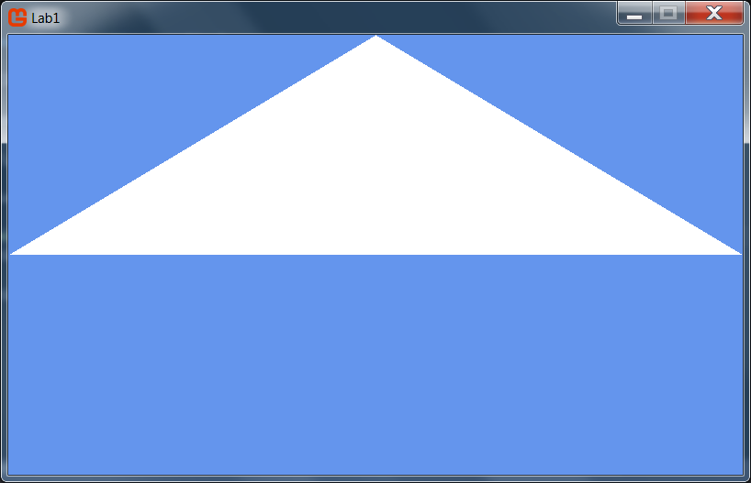
Output

Slide 11
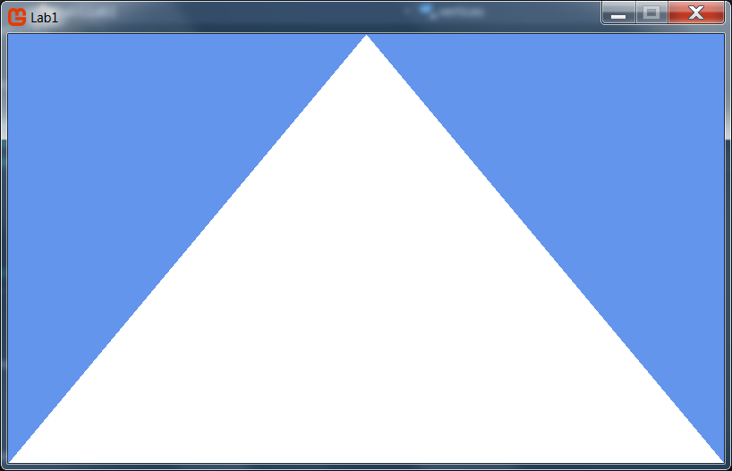
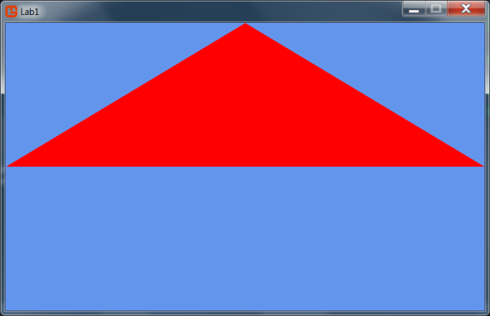
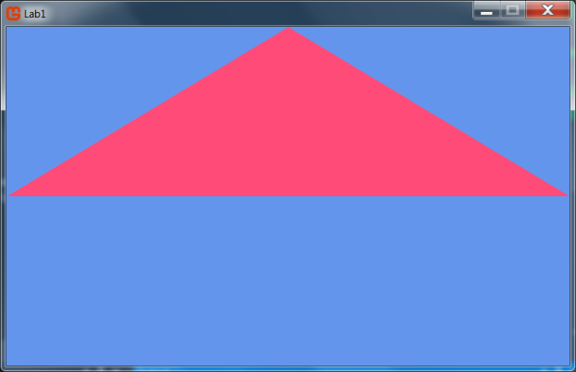
Exercises
Edit the code to generate the following outputs.
Save the screen shot images.
*)Use the BlendState.AlphaBlend in the Draw() method to make a transparent color.

Slide 12
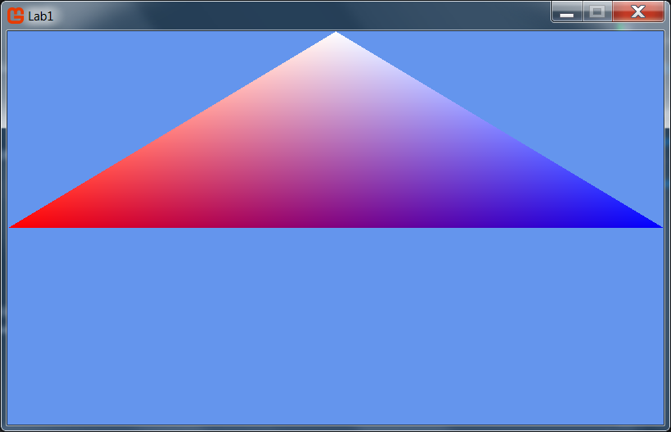
Simple Color Shader
How to generate the following output?
Look at the vertices with colors. How to pass the color data to the shader?

Slide 13
Exercise
Create a new shader file named SimpleColorShader
Add the struct VertexPositionColor
float4 Position: POSITION
float4 Color: COLOR
Modify the vertex and pixel shader to pass a position and get a color value.
Extra) Test each code in the pixel shader before return the color
color.r = 0;
color.rb= 0;
color.rb = color.br;
color = 1 – color;
color += 0.3f

Slide 14
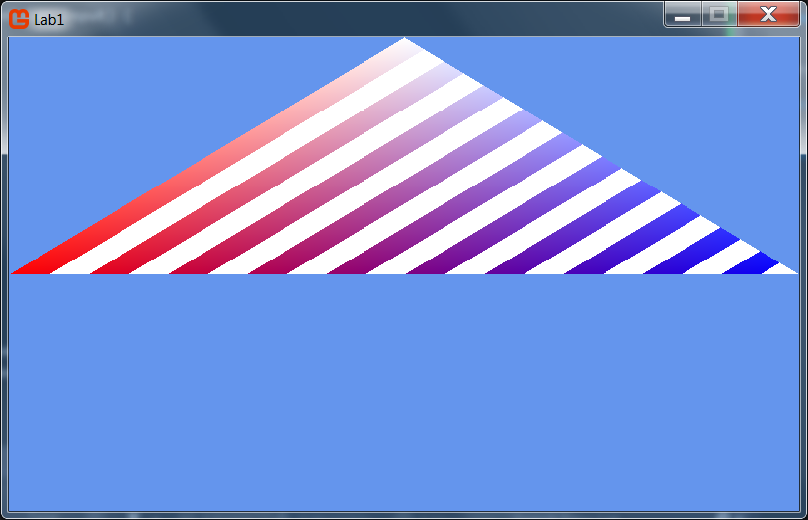
if (color.r %0.1 < 0.05f)
return float4(1, 1, 1, 1);
else return color;

Slide 15
Next
Lab#1
Update the simplest shader to show the image inside the triangle
Reading Homework
Chapter 2: Cg Tutorial
http://http.developer.nvidia.com/CgTutorial/cg_tutorial_chapter02.html

